Slide 1
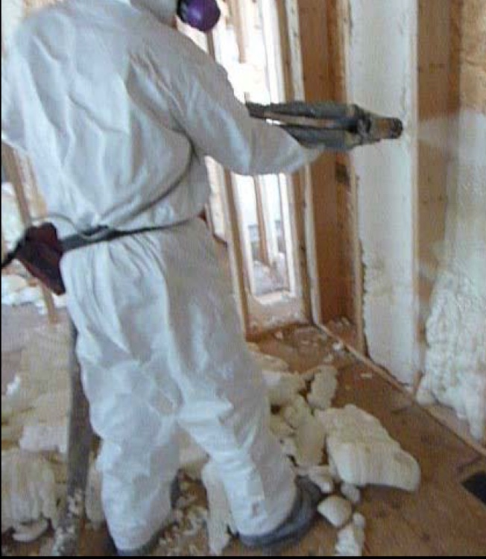
When is it “green”?
Preventing the toxic effects of spray foam insulation
Presented at the
NYS Green Building Conference, 2017
Course No: USGBCNYU_LCA
Greg Siwinski, MS, Certified Industrial Hygienist (Occupational Health Clinical Centers)
Jim Vallette (Healthy Building Network)
Dorothy Wigmore, BSc Occupational Hygiene, MS (Occupational Health Clinical Centers)

Slide 2
Credit(s) earned on completion of this course will be reported to AIA CES for AIA members. Certificates of Completion for both AIA members and non-AIA members are available upon request.
This course is registered with AIA CES for continuing professional education. As such, it does not include content that may be deemed or construed to be an approval or endorsement by the AIA of any material of construction or any method or manner of handling, using, distributing, or dealing in any material or product.
_______________________________________
Questions related to specific materials, methods, and services will be addressed at the conclusion of this presentation.

Slide 3


What are the Occupational Health Clinical Centers?
established over 25 years ago to address the dearth of independent occupational health expertise in NYS, focus on preventing occupational diseases
part of a State-wide network of 11 centers, publicly funded by the State Department of Health (DOH) – Syracuse, Binghamton, Canton
affiliated with Upstate Medical University’s Family Medicine Department
provide:
  medical evaluations
  prevention services
  training and education
  public health surveillance and Intervention
unique in the USA
http://www.ohccupstate.org

Slide 4

What is the Healthy Building Network?
founded in 2000
work to reduce the use of hazardous chemicals in building products as a means of improving human health and the environment
Pharos database and other chemical hazard information
healthybuilding.net

Slide 5
What are we going to talk about?
Using a life cycle framework, this presentation will bring together information from several perspectives. After reviewing their chemistry, and where and how isocyanates are used in building products, we will review the historical and current ingredients and uses of SPF in buildings.
We will present health concerns about these uses raised by fenceline communities, occupational and environmental health studies, fire fighters and fire investigators, and others along the life cycle of this product-- with a focus on the toxic ingredients in SPF. Those concerns include reports from a Syracuse occupational health clinic about the experiences of work crews and building occupants. They will be supplemented by concerns and questions from building scientists, occupational and environmental health agencies and researchers, and other important sources over the years.
Given these concerns, we will recommend theoretical and practical approaches to prevention of adverse health effects throughout the life cycle of building products, including reliable information sources to ascertain the concerns and uncertainty about the use of specific chemicals and products (e.g., the Pharos database) and informed substitution. We will present concrete examples of less toxic substitutions by application for SPF and discuss how a precautionary green chemistry framework meets the goal of sustainable buildings that are healthy and safe for all.

Slide 6
What are the learning objectives
By the end of this presentation, participants will be able to:
Identify hazards and impacts associated with the use of SPF and isocyanates in building materials, using a life cycle framework.
Discuss how to incorporate scientific uncertainty and public health's precautionary principles when considering choices for the mass use of materials in buildings, trying to avoid serious consequences.
Apply informed substitution approaches in the choice of building materials, especially for SPF applications.
Ask the questions "What about the workers? What about the community? What about the users?" when considering specific building materials.

Slide 7
What’s the plan for this presentation?
How have isocyanates been used in building products? Why?
What are the problems with using isocyanates, especially in spray foam insulation? (health, others in a systems/life cycle approach)
So what’s “green” about spray foam insulation products?
What needs to be done? (some recommendations)

Slide 8
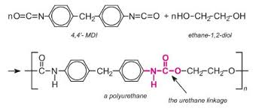
What are isocyanates?
invented in Germany (1930s)
derived from oil and natural gas
major feed chemicals include: benzene, aniline, formaldehyde (all carcinogens)
polymerization by the addition of polyols [containing hydroxyl groups (Part B)]
toluene diisocyanate (TDI)
hexamethylene diisocyanate (HDI)
methylene diphenyl diisocyanate (MDI)

Slide 9

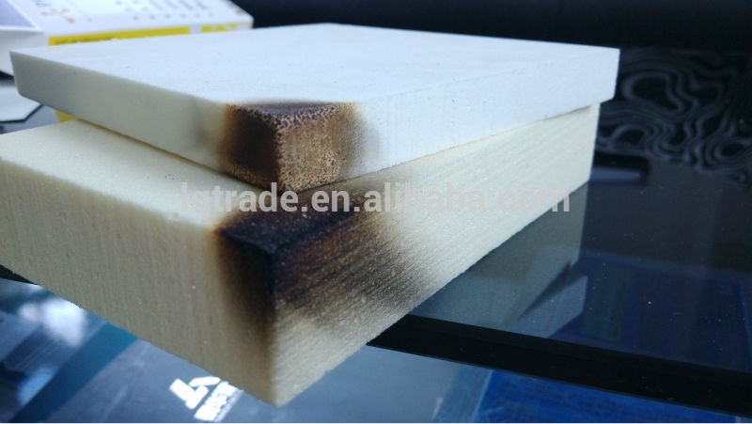
How have isocyanates been used in building products?
construction is the leading end use for polyurethane.
more than half the polyurethane in construction is rigid construction foam insulation
rigid foam accounts for 20% of overall polyurethane demand
Free (unreacted) isocyanates are found in:
  spray foam insulation
  polyisocyanurate wall insulation board
  joint sealants
  fireblock sealants
  flooring and casework adhesives
  engineered wood (flooring, particleboard, casework, cross-laminated timber)
  fluid-applied flooring
  rubber cork flooring
  carpet (backing)
  UV-cured urethane acrylic finishes (e.g., wood flooring finishes)

Slide 10
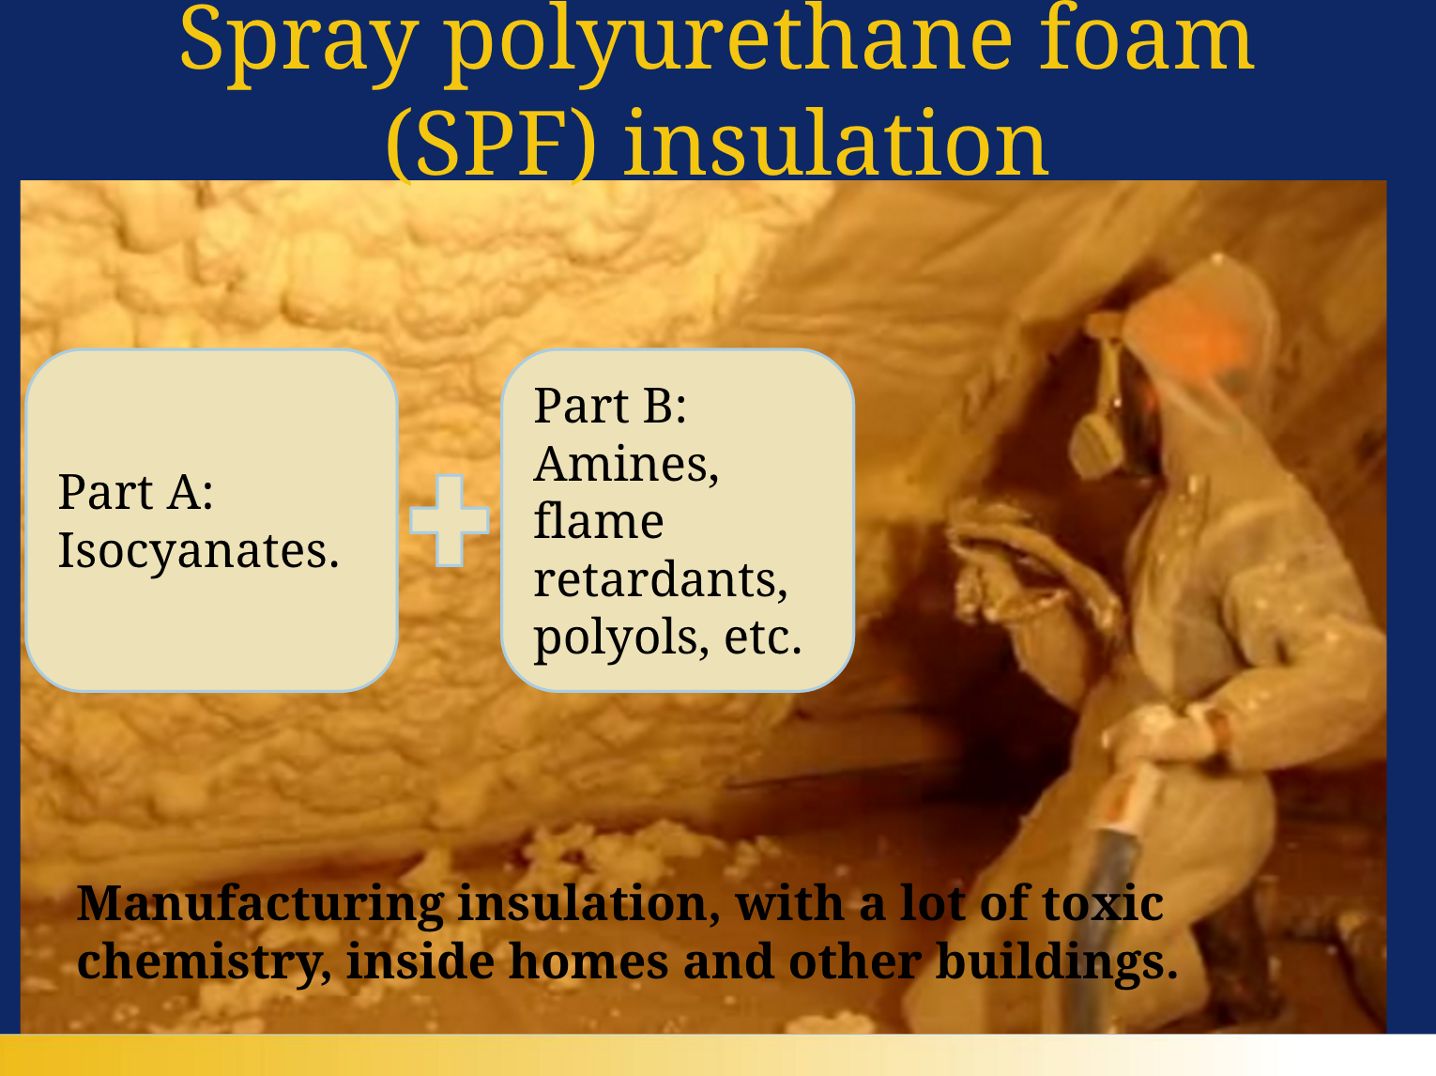

Slide 11
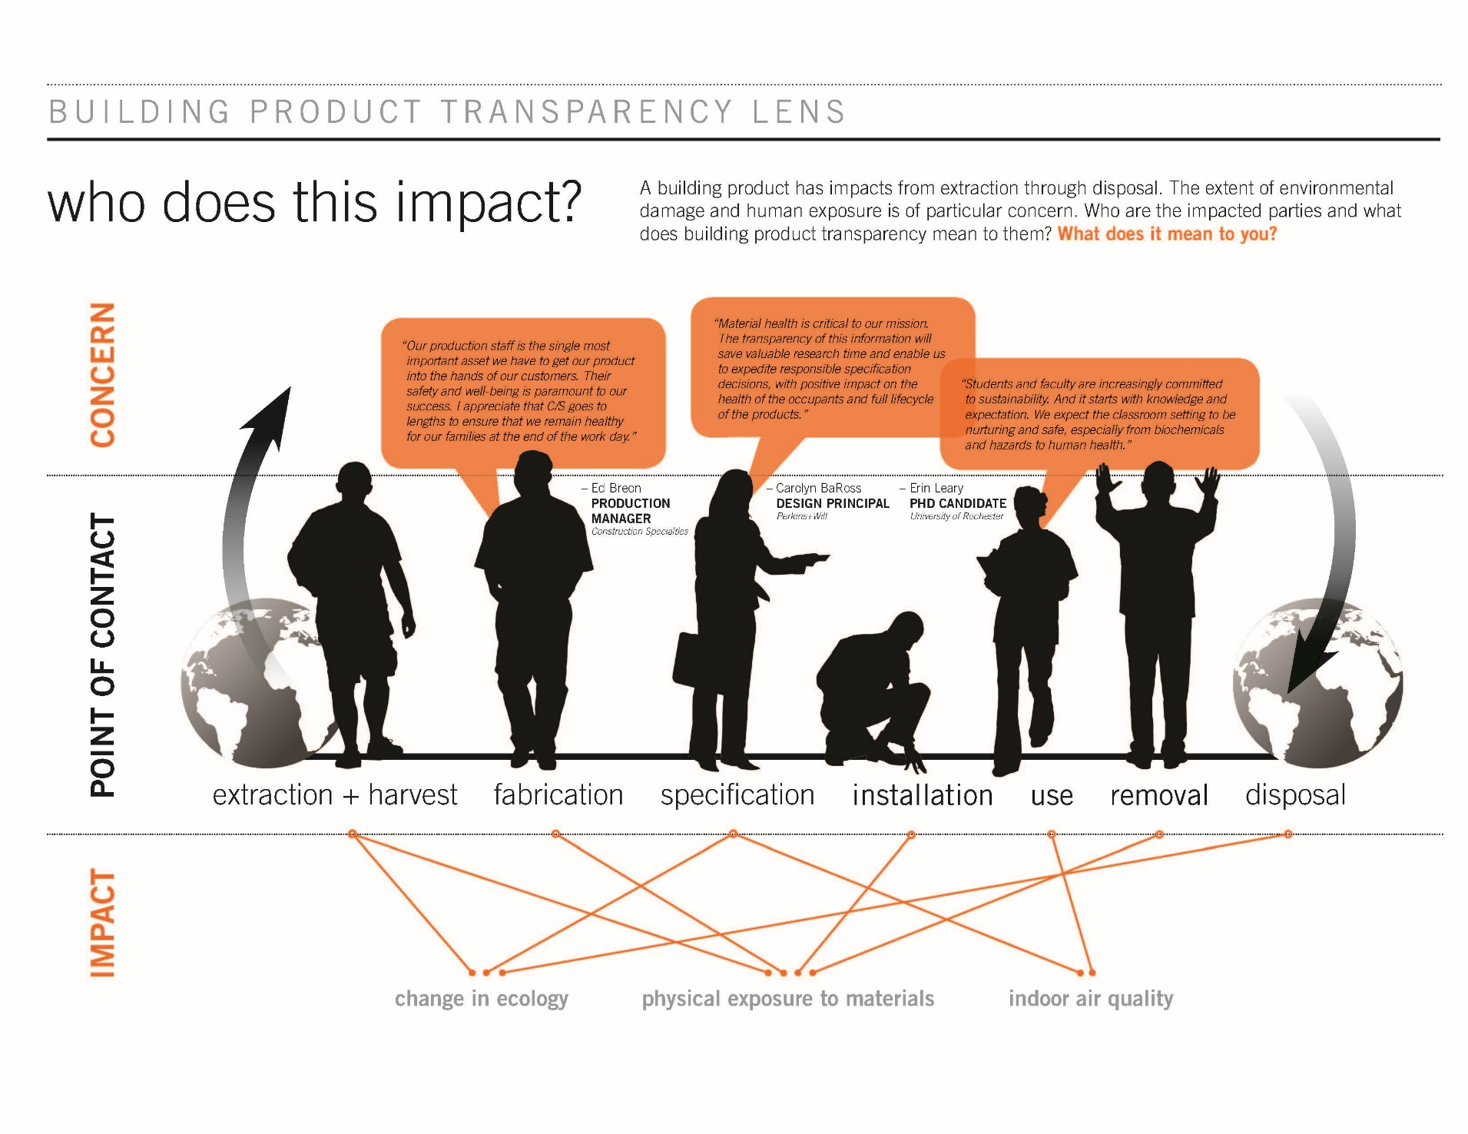
Taking a systems (life cycle) approach
Perkins + Will graphic
And asking the question at each stage: Who’s affected? Workers? Home owners?

Slide 12
What are the problems with using isocyanates, especially in spray foam insulation?
Health effects
manufacturing facilities
fenceline communities
applicators/mixers/installers
renovation/repair work
home owners/families
fire fighters and others caught in fires
Fire hazards
Other (e.g., global warming)

Slide 13
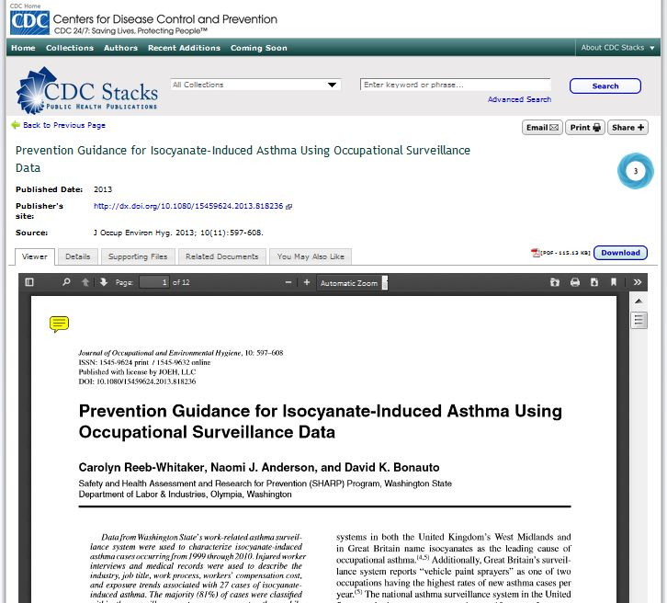
Health effects of isocyanates?
numerous published studies over the last 40 years confirm the health hazards of isocyanates
potent skin, eye, respiratory irritant (1950)
respiratory effects reported include:
  asthma in production workers/users (1960), sensitization reports (1973)
  fatal asthma cases reported (1988)
  hypersensitivity pneumonitis
  respiratory sensitization via skin/dermal contact
  continued reports from disease surveillance systems showing work-related asthma in workers
  isocyanates considered a leading cause of work-related asthma (2015)
cancer:
TDI: lung cancer in animal studies, however not classifiable in humans;
MDI: limited evidence in animals (IARC)

Slide 14
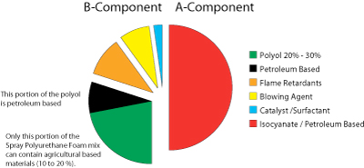
Health effects – spray foam products part B (amines)?
Health effects – spray foam products part B (other ingredients)?
can trigger allergic reactions
headache, nausea
rapid heart rate
itching, hives
corneal edema “halo vision”
hazy vision
dilated pupils
flame retardants: interfere with hormones, reproductive systems, thyroid and metabolic function, and neurological development in infants and children; cancers in fire fighters?
blowing agent: fire hazard

Slide 15
How useful are occupational exposure limits (OELs)?
only a few isocyanates have OELs/PELs (eg TDI, MDI)
isocyanate OELS are among the lowest set by OSHA and NIOSH
  OSHA: 0.02 ppm ceiling (MDI)
  NIOSH: 0.005 ppm, 0.02 ppm ceiling (MDI)
  California’s OEHHA recommends for MDI:
  acute reference level: 0.0012 ppm
  8-hour reference level: 0.000015 ppm
  chronic reference level: 0.000008 ppm
  for comparison, formaldehyde:
  OSHA: 0.75ppm, 2ppm STEL
even these extremely low OELs do not protect sensitized people

Slide 16
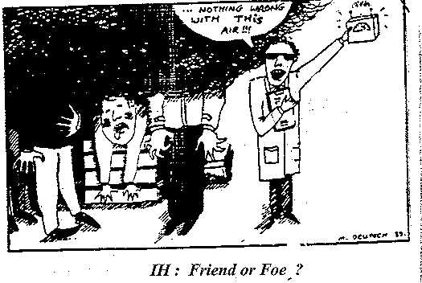
How well can we measure isocyanates?
historic measurements are most likely under-estimates, due to sampling techniques
any challenges to collect samples that represent true exposures

Slide 17
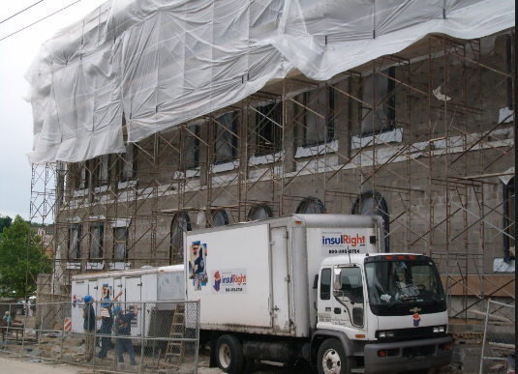
What’s the real world experience with spray foam products?
more than 90 percent of in-the-field exposure measurements in Vermont and Massachusetts were above the relevant OELs
there is routine failure to provide adequate worker protections on the job (ventilation, skin and breathing protection, and lack of training)
building occupants reacting to these products as well
2,400 pounds of TCPP per 100,000 square feet

Slide 18
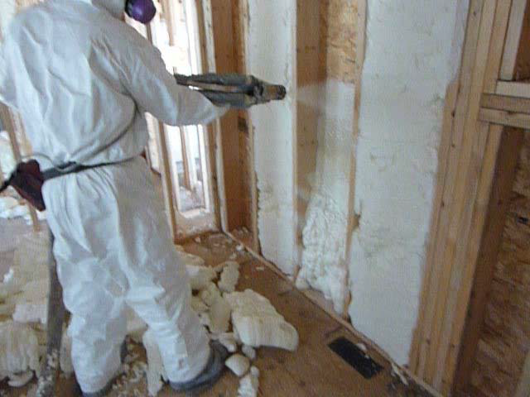
Application variables: thickness, temperature, humidity

Slide 19
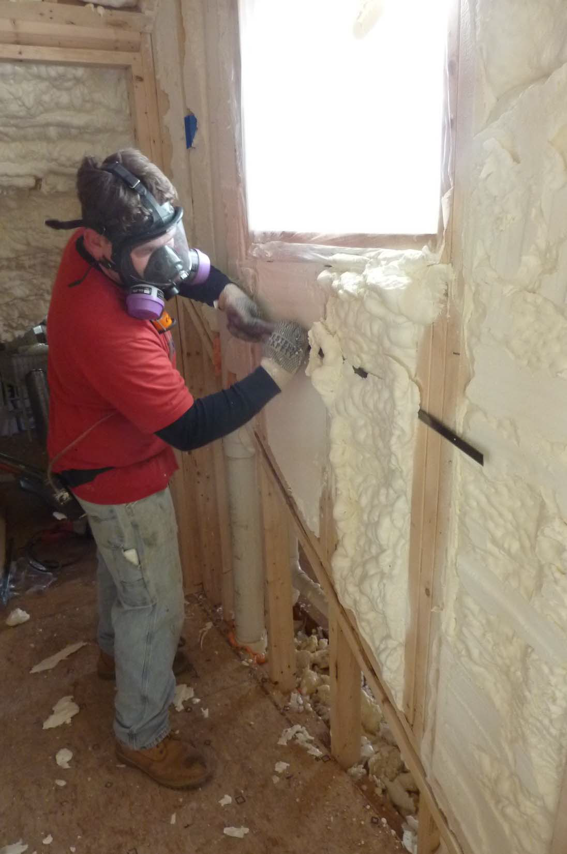
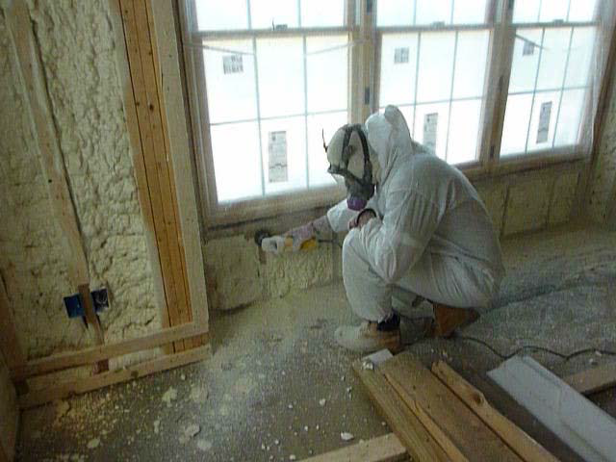
Trim work

Slide 20
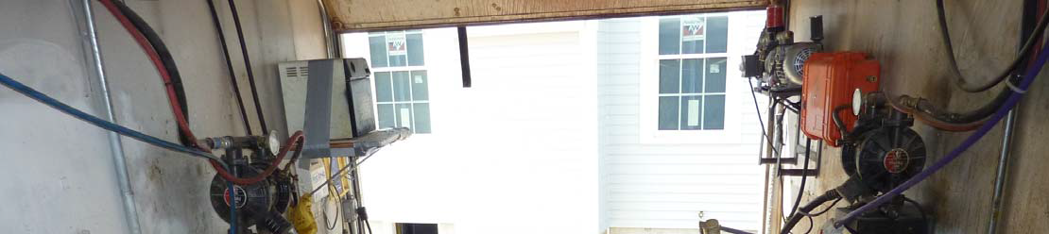
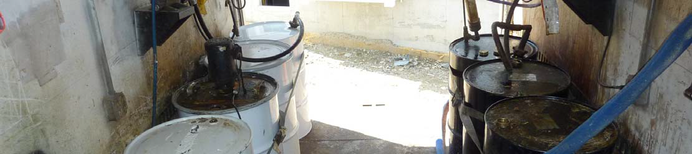
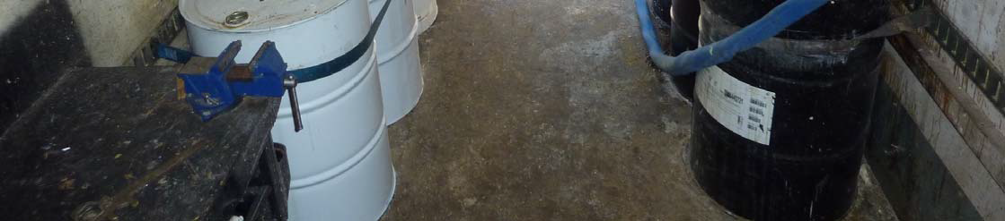
A drum on right, B drum on left

Slide 21
What about the OHCC experience?
six separate episodes presented to the OHCC over a three-year period, involving 10 patients
installer/workers found with classic work-related asthma (WRA) due to inadequate protective measures on the job (paper dust mask)
home owners had breathing and nervous system health effects preventing their use of their homes, and normal daily activities affected too
for home owners and their families, contributing factors include lack of adequate warnings and clearance times, faulty installations

Slide 22
Case example #1
a family of four presented with watery eyes, sore throat, chest tightness, congestion, headache, and night sweats
symptoms started subsequent to returning home a few hours after foaming was completed
after several remediation efforts the foam was physically removed but proved ineffective
unable to occupy home and continue to experience reactions in day to day activities

Slide 23
Case Example #2
a spray foam installer presented with severe shortness of breath and asthma after two years of spray foaming work
typically, spray foamed in crawl spaces, attics, and basements with limited air movement
inadequate workplace protections and training contributed to his on-going breathing problems

Slide 24
How has hazard prevention failed?
lack of a “sane appreciation of hazards” associated with foam insulation methods
lack of protective measures for installers and building occupants
installers unable to deal with the complicated chemistry involved in these systems
false sense of security offered by the industry and suppliers of these reactive chemical systems , “safe use myth”
no evidence for recommended “clearance” times
end of life/sustainability issues

Slide 25
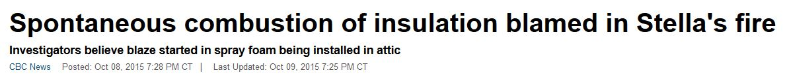
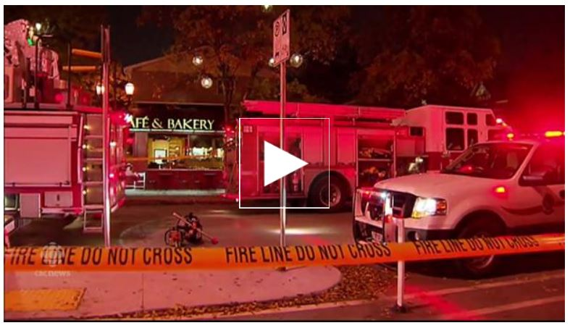
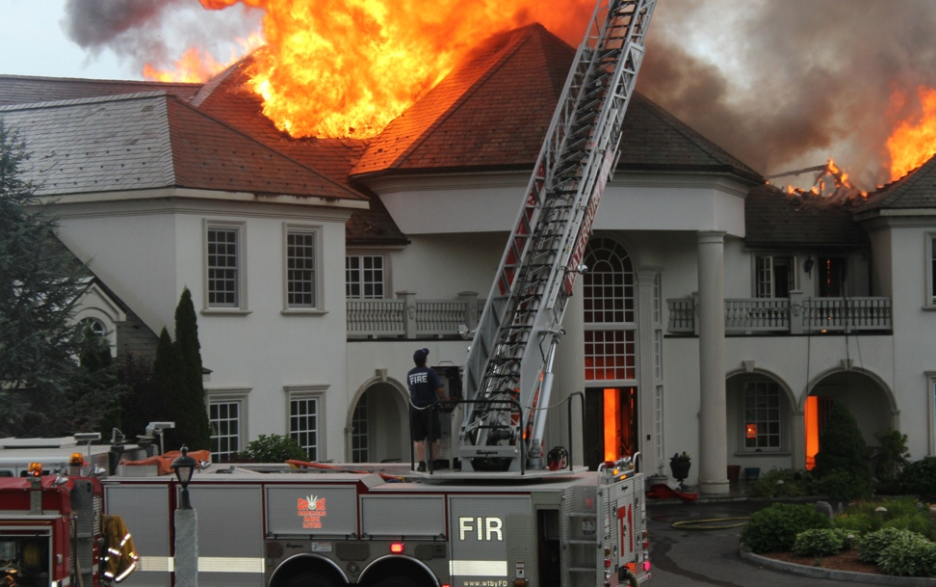
Fire hazards
fires have occurred during spray foam installation projects, most likely caused by the exothermic reaction that occurs during application
the in-place cured foam increases the thermal fuel source of a building
toxic fire decomposition products increase hazards to fire fighters on the fire ground
The $5 million Connecticut home of “Dr. Energy” founder, Larry Janesky, went up in flames in 2014. The cause: spontaneous combustion of polyurethane foam insulation.

Slide 26

How about global warming effects?
halogenated blowing agent 1000 x more potent than CO2 for global warming potential
closed cell spray foam ingredients contribute to elevated ozone-depleting chemicals in stratosphere
newer blowing agents (hydrofluoro-olefins/HFOs) produced using carcinogenic carbon tetrachloride – a powerful ozone-depleting chemical
already getting increased carbon tetrachloride emissions as HFOs become standard blowing agents and refrigerants

Slide 27
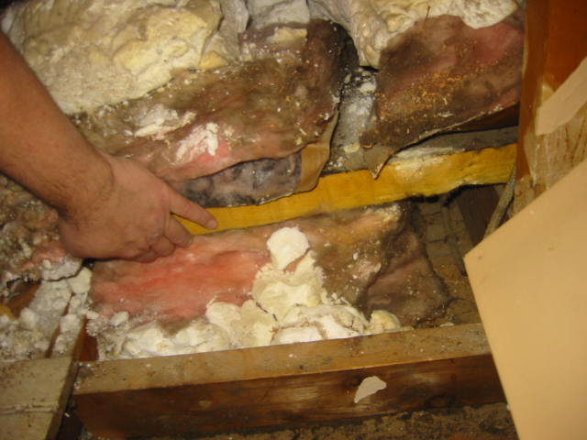
Is this a repeat performance ?
urea formaldehyde foam insulation (UFFI) use in the 1970’s was halted due to health concerns
formaldehyde is a known lung hazard, sensitizer, and carcinogen
urea formaldehyde foam insulation degrades to powder and settles in building cavities after 20 years
what about isocyanate foam insulation sustainability?
making a comeback? “amino foam”

Slide 28
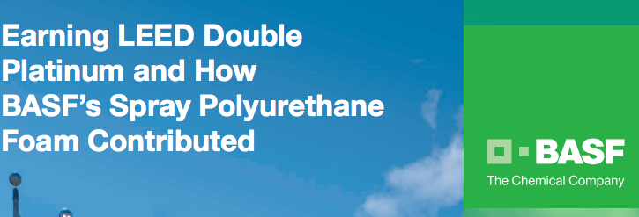
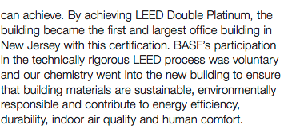
”Green” product certifications and isocyanates
Indoor air quality certifications don’t consider isocyanates, which are not among the VOCs tested by the standard programs used by these certifiers.
These IAQ certifications, in turn, help building projects obtain LEED® certifications by using SPF Insulation
Certifies cork and recycled rubber flooring with MDI binder
Certifies
flooring finish with HDI hardener;
many SPF insulation products
Solution: Transparency (full disclosure of product ingredient information) and consumer diligence

Slide 29
Why did Green Seal certify spray foam insulation?
In 2016, despite widespread concern, Green Seal opened the door to certifying spray foam insulation
By Tom Lent, Jim Vallette and Rebecca Stamm
Healthy Building Network
Endorsements: Forty organizations formally requested to endorse HBN’s proposals on the Standard. About half of them are members of architecture, engineering, or development firms or otherwise directly engaged in the design and specification process in the AEC community.
.. HBN Recommends… That Green Seal delete its exemption for MDI, and categorically decline to certify spray polyurethane foam insulation until safer formulations are available. Specifically, the standard should adopt this language:
“Due to significant problems with respiratory injury to workers and occupants from isocyanates in spray polyurethane foam insulation, Green Seal certification is not available for the spray foam insulation category at this time.

Slide 30
OHCC: .. In addition to the adverse health effects reported by our patients, we also are greatly concerned about the loss of employment and permanent disability for the installation workers and the inability of others to occupy their homes.
Therefore, Green Seal should not consider the use of isocyanate spray foam insulation systems (including MDI components) as a safe and healthy product, as proposed in GS-54 Standard. Green Seal should not use Section 5.0 of the proposed standard to shirk its responsibility to clearly prohibit isocyanate spray foam insulation systems (including MDI) in the GS-54 Standard.
.. OEHHA warns that the very low Reference Exposure Limits (RELs) may not protect all individuals previously sensitized to MDI or PMDI. Surely Green Seal does not want to promote or allow the use of chemicals that cause harm to people exposed in the .008 to 1.2 parts per billion range.
To paraphrase Dr. Rosenman, insulation workers, firefighters, employers and home residents will pay the price if Green Seal certifies products containing MDI and other toxic chemicals. This standard is an opportunity to push for the development of less toxic building materials, to go beyond the current situation. The small un-ventilated spaces in which foam insulation is applied present a serious challenge to implement engineering controls and PPE – a challenge better met through informed substitution. Otherwise, you leave small and large businesses, workers they employ, and all who inhabit or work in spaces where insulation is applied, to grapple with environments that are much less healthy and safe than they could and should be.

Slide 31
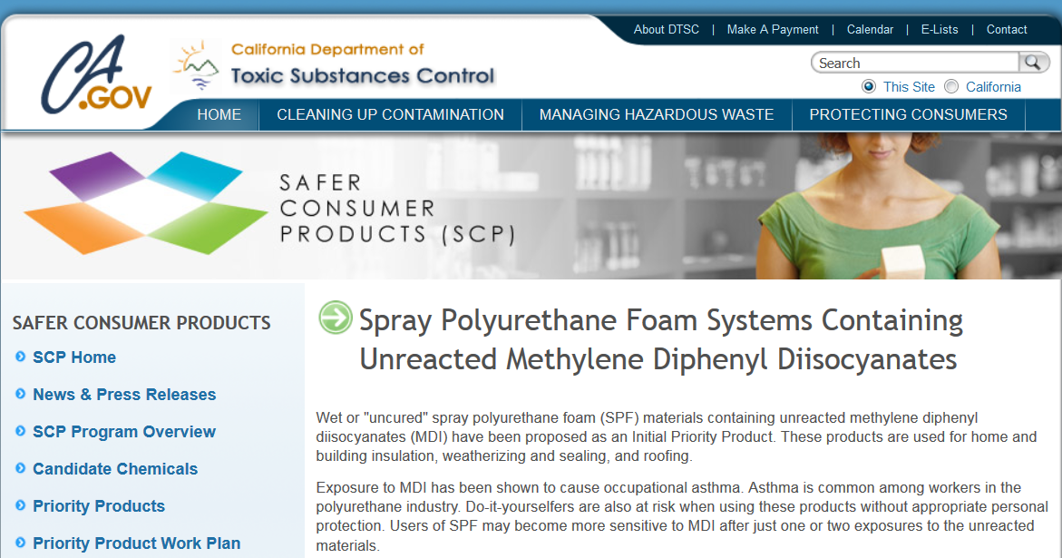
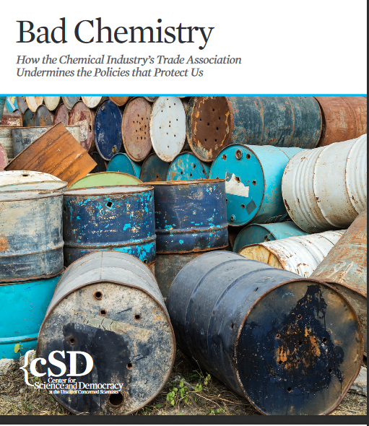
What’s happening in California?
Department of Toxic Substances Control (DTSC) first “priority products” for alternatives assessment include unreacted MDI in spray polyurethane foam products (started out as unreacted diisocyanates in spray polyurethane foam systems)
American Chemistry Council made this one of its recent top “targets” to oppose
possible because Safer Consumer Product Regulations recognised occupational health is part of public health and workers are a “sensitive population”
result of union, COSH group, public health actions and input

Slide 32
What kinds of alternatives are available?
APPLICATION | FIRST CHOICE | PREFERRED ALTERNATIVE | SECONDARY ALTERNATIVE
Attic Ceiling, Basement Ceiling, Cathedral Ceiling, Attic Floors | Unfaced fiber glass batt insulation with no hazardous (GreenScreen BM-1 or LT-1) de-dusting oil and a minimum of 60% post-consumer recycled content. | Blown-in fiber glass, fiber glass batts (all) spray-applied fiber glass (ceilings only) | Blown-in cellulose, cotton/cellulose batts
Open Wall Cavities | Unfaced fiber glass batt insulation with no hazardous (GreenScreen BM-1 or LT-1) de-dusting oil and a minimum of 60% post-consumer recycled content. | Blown-in fiber glass (dense pack), spray-applied fiber glass, fiber glass batts | Blown-in cellulose (dense pack), wet-blown cellulose, cotton/cellulose batts
Crawl Space | Expanded cork board insulation or unfaced fiber glass as described above. | Fiber glass batts | Fiber glass basement wall insulation, cotton/cellulose blanket or batt insulation
 |  | From forthcoming Healthy Building Network/NRDC Guide to Energy Efficiency Retrofits
SPF Insulation Alternatives
Draft Recommendations from forthcoming Healthy Building Network / Natural Resources Defense Council guide

Slide 33

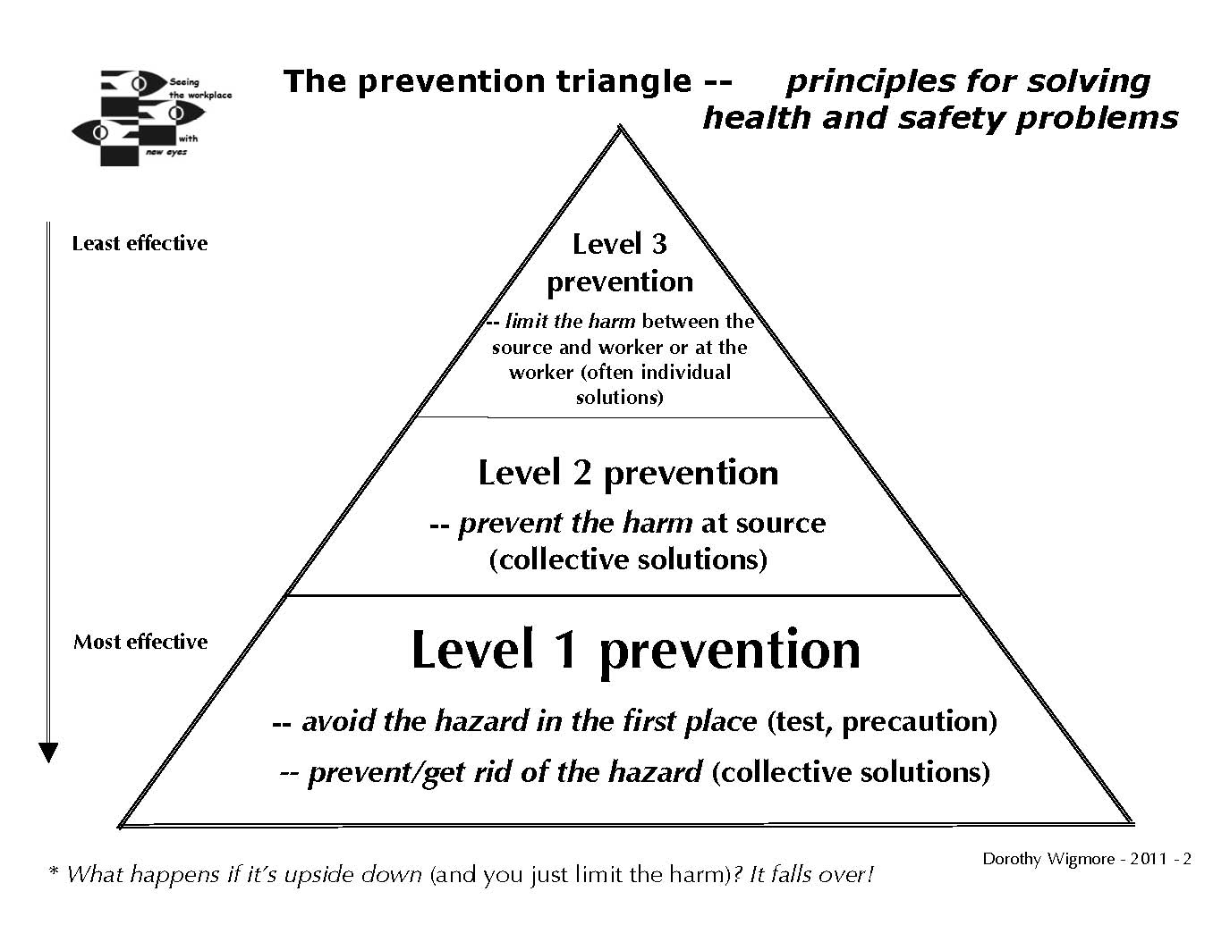
What needs to be done? (some recommendations)
precaution – recognize scientific uncertainty, and what is known (not “alternative facts”)
prevention, not limiting the harm
toxics use reduction
informed substitution

Slide 34
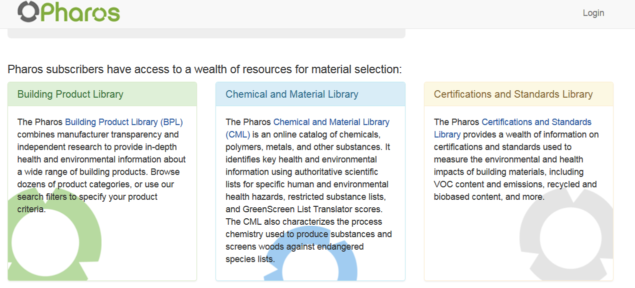
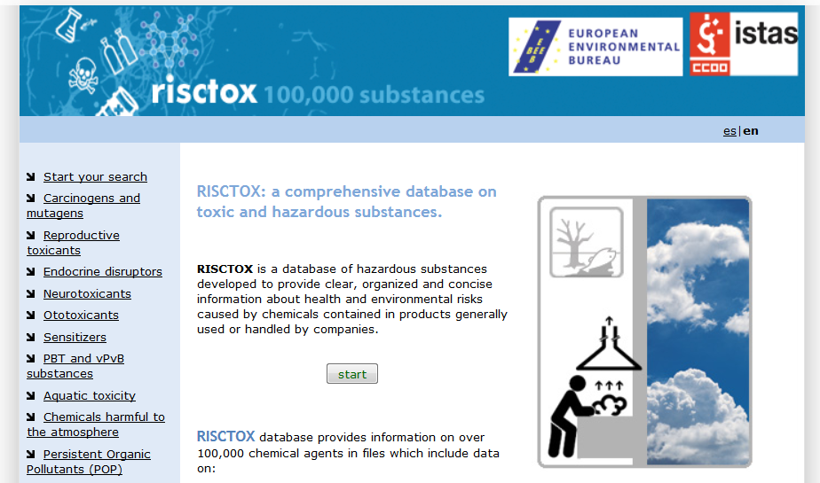

independent data (e.g., Pharos database, Risctox, Green Screen)
transparency
systems/life cycle approaches
always ask: What about the workers? What about the building occupant? Who else can be affected?

Slide 35
What if spray foam products are used?
  prior informed consent for building occupants
  certified trained installers, by credible independent body
  bonded contractors
  mandatory safe and healthy work practices, reliable clearance times, etc.
  consider what this means for “green” certifications, designations
  inventory/record of where it was used (shared with fire departments)

Slide 36

What are your questions?

Slide 37

This concludes The American Institute of Architects Continuing Education Systems Course
U.S. Green Building Council
Tracie Hall, Director-
New York Upstate
thall@usgbc.org

